Slide 1
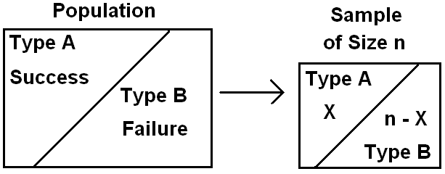
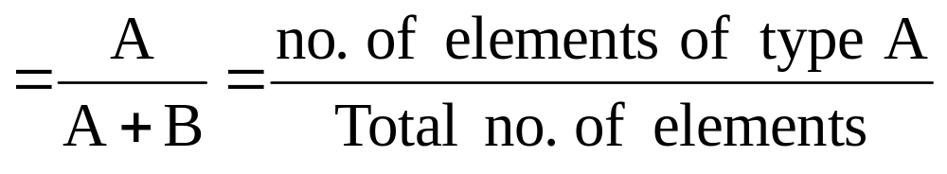

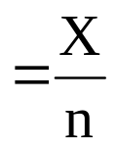
Single Sample: Estimating of a Proportion:
.p = Population proportion of successes (elements of Type A) in
the population
.n = sample size
X = no. of elements of type A in the sample of size n.
= Sample proportion of successes (elements of Type A) in
the sample

Slide 2

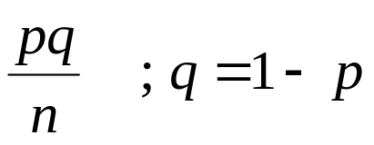
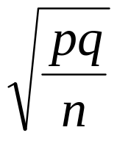
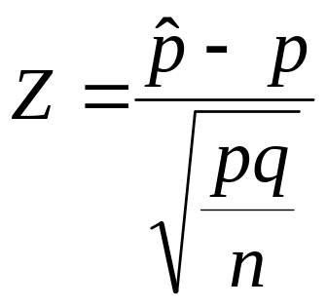
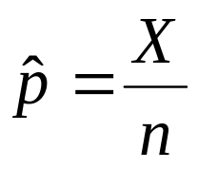
Recall that:
(1) X ~ Binomial (n, p)
(2) E( )= E( )= p
(3) Var( ) = Var( ) =
(4) For large n, we have
~ N(p, ) (Approximately)
~ N(0,1) (Approximately)
Point Estimation for p:
A good point estimator for the population proportion p is given by the statistic (sample proportion):

Slide 3
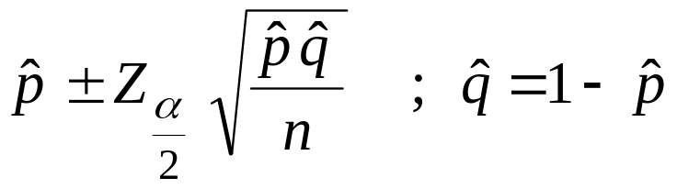
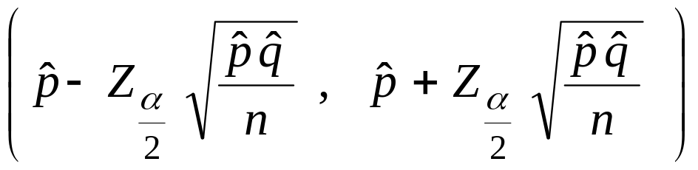
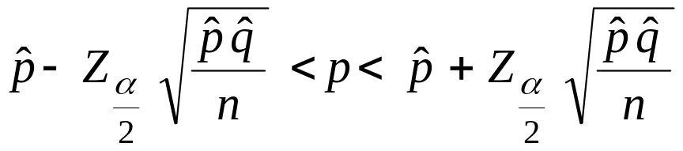
Confidence Interval for p:
Result:
For large n, an approximate (1−α)100% confidence interval for p is :
or
or

Slide 4
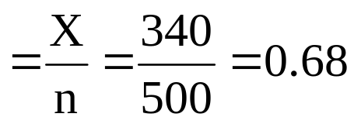

Example:
In a random sample of n=500 families owing television sets in the city of Hamilton, Canada, it was found that x=340 subscribed to HBO. Find 95% confidence interval for the actual proportion of families in this city who subscribe to HBO.
Solution:
.p = proportion of families in this city who subscribe to HBO.
.n = sample size = 500
X = no. of families in the sample who subscribe to HBO=340.
= proportion of families in the sample who subscribe to HBO.
A point estimator for p is

Slide 5
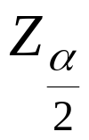
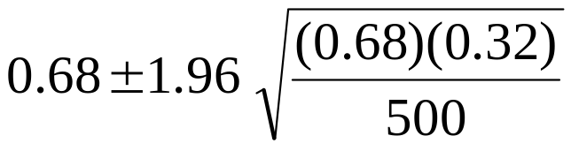

Now,
95% = (1−α)100% ⇔ 0. 95 = (1−α) ⇔ α=0.05 ⇔ α/2 = 0.025
= Z_{0.025} = 1.96
A 95% confidence interval for p is:
0.64< p < 0.72
We are 95% confident that p ∈(0.64,0.72).

Slide 6
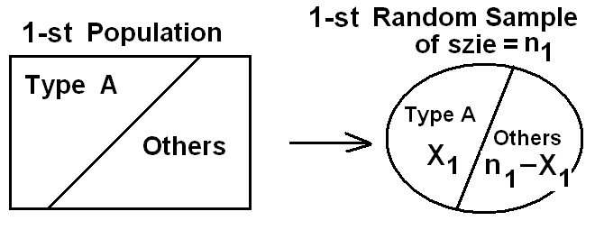
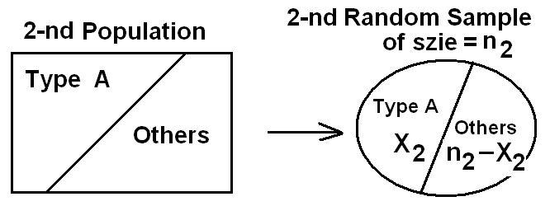
Two Samples: Estimating the Difference between Two Proportions:
Suppose that we have two populations:
· .p₁ = proportion of the 1-st population.
· .p₂ = proportion of the 2-nd population.

Slide 7
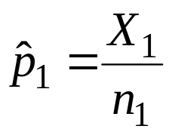
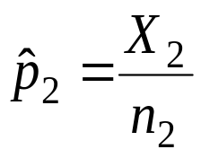
· We are interested in comparing p₁ and p₂, or equivalently, making inferences about p₁− p₂.
· We independently select a random sample of size n₁ from the 1-st population and another random sample of size n₂ from the 2-nd population:
· Let X₁ = no. of elements of type A in the 1-st sample.
X₁~Binomial(n₁, p₁)
E(X₁)= n₁ p₁
Var(X₁)=n₁ p₁ q₁ (q₁=1− p₁)
· Let X₂ = no. of elements of type A in the 2-nd sample.
X₂~Binomial(n₂, p₂)
E(X₂)= n₂ p₂
Var(X₂)=n₂ p₂ q₂ (q₂=1− p₂)
·
= proportion of the 1-st sample
·
= proportion of the 2-nd sample

Slide 8


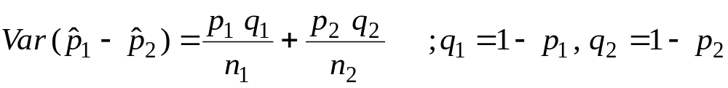
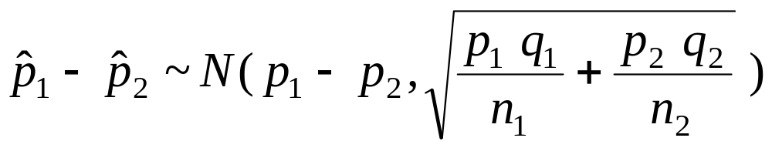
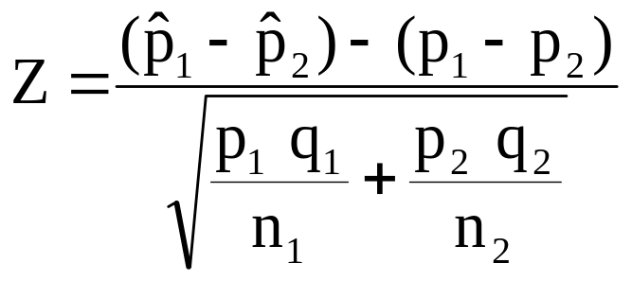
· The sampling distribution of is used to make inferences about p₁− p₂.
Result:
( 1 )
( 2 )
( 3 )
For large n₁ and n₂, we have
(Approximately)
(Approximately)

Slide 9
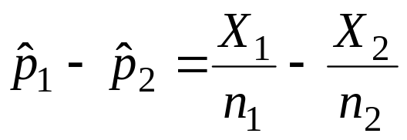
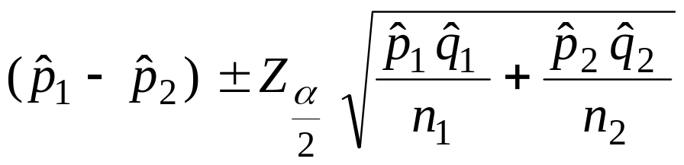
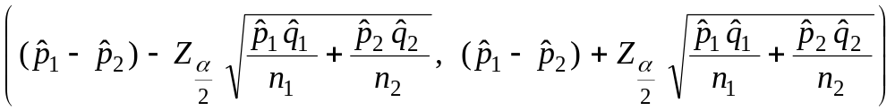
Point Estimation for p₁− p₂:
A good point estimator for the difference between the two proportions, p₁− p₂, is given by the statistic:
Confidence Interval for p₁− p₂:
Result:
For large n₁ and n₂, an approximate (1−α)100% confidence interval for p₁− p₂ is :
or

Slide 10
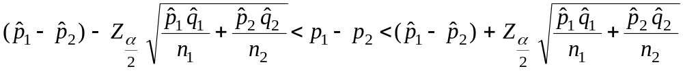
or
Example:
A certain change in a process for manufacture of component parts is being considered. Samples are taken using both existing and the new procedure to determine if the new process results in an improvement. If 75 of 1500 items from the existing procedure were found to be defective and 80 of 2000 items from the new procedure were found to be defective, find 90% confidence interval for the true difference in the fraction of defectives between the existing and the new process.

Slide 11


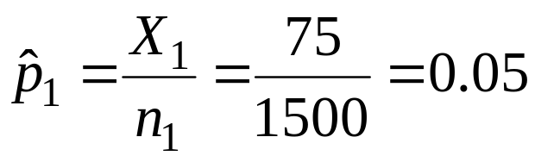
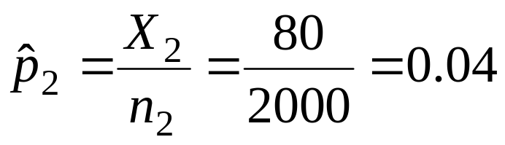



Solution:
p₁ = fraction (proportion) of defectives of the existing process
p₂ = fraction (proportion) of defectives of the new process
= sample fraction of defectives of the existing process
= sample fraction of defectives of the new process
Existing Process New Process
n₁ = 1500 n₂ = 2000
X₁=75 X₂=80
Point Estimation for p₁− p₂:
A point estimator for the difference between the two proportions, p₁− p₂, is:

Slide 12
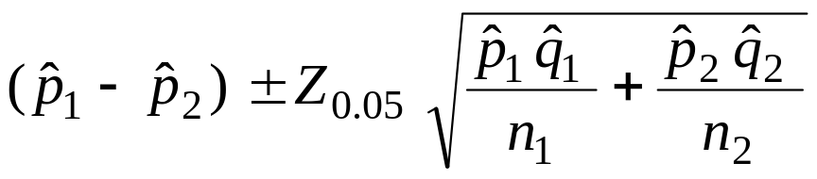
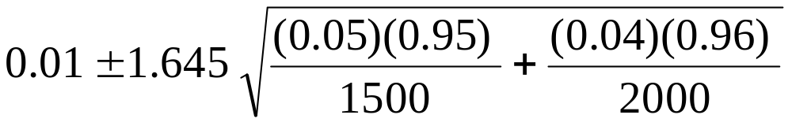

Confidence Interval for p₁− p₂:
A 90% confidence interval for p₁− p₂ is :
−0.0017 < p₁− p₂ < 0.0217
We are 90% confident that p₁− p₂ ∈(−0.0017, 0.0217).

Slide 13
Note:
Since 0∈90% confidence interval=(−0.0017, 0.0217), there is no reason to believe that the new procedure produced a significant decrease in the proportion of defectives over the existing method (p₁− p₂ ≈ 0 ⇔ p₁ ≈ p₂).

